Slide 1


Next generation - Microsoft Cognitive Services
Abdul Rasheed Feroz Khan
Founder & Director - CodeSizzler

Slide 2


Why Microsoft Cognitive Services?
#aos, @TechFero, @CodeSizzler

Slide 3
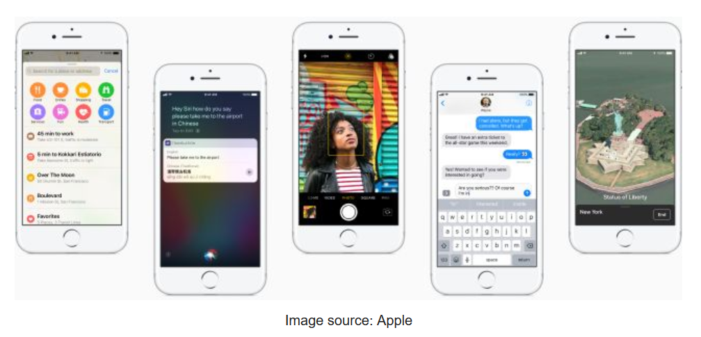
API’s - CoreML
#aos, @TechFero, @CodeSizzler

Slide 4
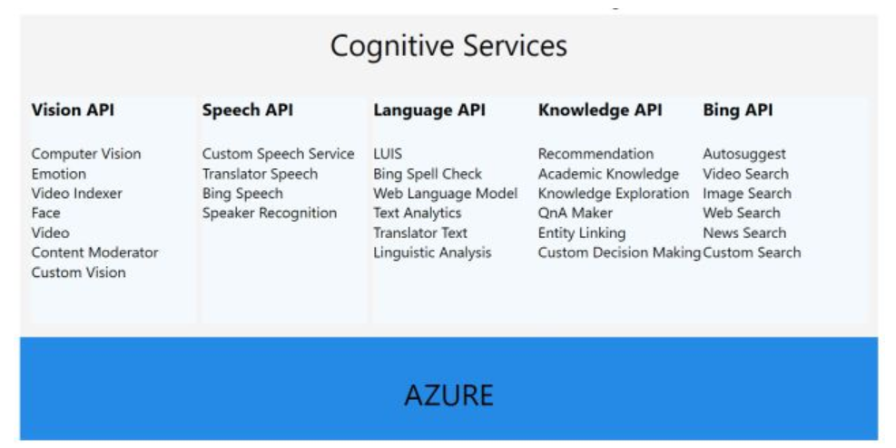
API’s – Cognitive Services
#aos, @TechFero, @CodeSizzler

Slide 5
Start with Cognitive Services http://bit.do/mcscodesizzler
#aos, @TechFero, @CodeSizzler

Slide 6
Try Cognitive Services here http://bit.do/mcsscodesizzler
#aos, @TechFero, @CodeSizzler

Slide 7
Demo on LUIS API
#aos, @TechFero, @CodeSizzler

Slide 8




